Slide 1

Introduction to Natural Language Processing
Paul Rad, Ph.D.
Associate Professor
Cyber Analytics and AI
Information Systems and Cyber Security
College of Business School
210.872.7259

Slide 2
Outline
Big Text Data and Processing
Rule-base approach
Probabilistic Machine Learning
Deep Learning approach
What is NLP
Application of NLP
What are the challenges?
Key NLP components

Slide 3
Big Text Data Analytics
Internet
Blogs
News
Email
Literature
Twitter
Websites
Reviews
Knowledge
Decision
Making

Slide 4
Text Analytics - Syntactic Analysis
Pierre Vinken 61 years old will join the board as a nonexecutive director Nov. 29
Syntactic Analysis
Lexical Analysis
Part of speech tagging

Slide 5
What is NLP
Natural language processing (NLP) is a field of computer science, artificial intelligence, and computational linguistics concerned with the interactions between computers and human (natural) languages. – Wikipidia

Slide 6
NLP Pyramid
Pragmatics
Semantics
Syntax
Morphology
Morphology - is the study of words, how they are formed, and their relationship to other words in the same language.
Syntax - is the set of rules, principles, and processes that govern the structure of sentences in a given language, usually including word order
Semantics - is the linguistic and philosophical study of meaning, in language, programming languages, formal logics, and semiotics
Examples of Semantics:
A child could be called a child, kid, boy, girl, son, daughter.
Pragmatics a subfield of linguistics and semiotics that studies the ways in which context contributes to meaning

Slide 7
Text Mining
1. Natural language processing
2. Word association mining and analysis
3. Topic mining and analysis
4. Opinion mining and sentiment analysis
5. Event Prediction

Slide 8
Syntactic Analysis
Pierre Vinken 61 years old will join the board as a nonexecutive director Nov. 29

Slide 9
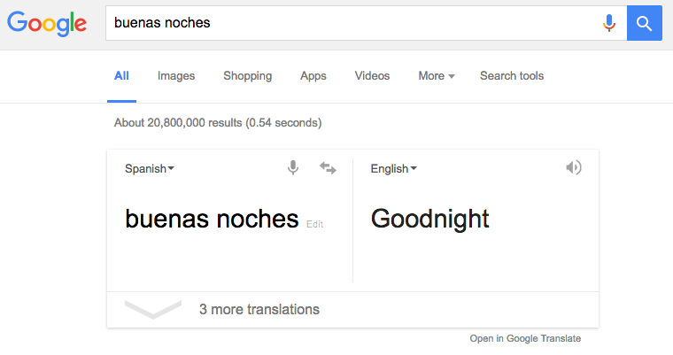
Machine translation

Slide 10
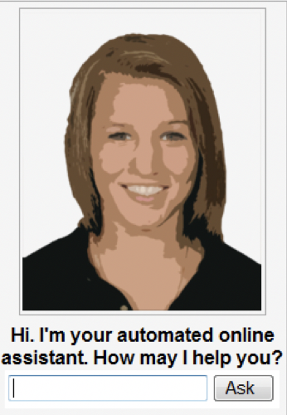
Dialog Systems

Slide 11
Sentiment

Slide 12

Language model applications
Autocomplete

Slide 13
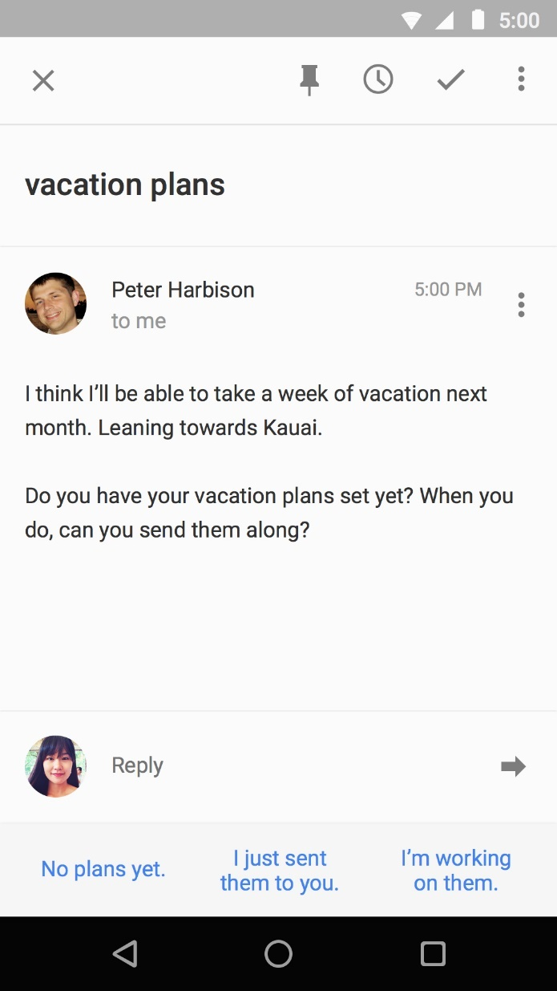
Language model applications
Smart Reply

Slide 14

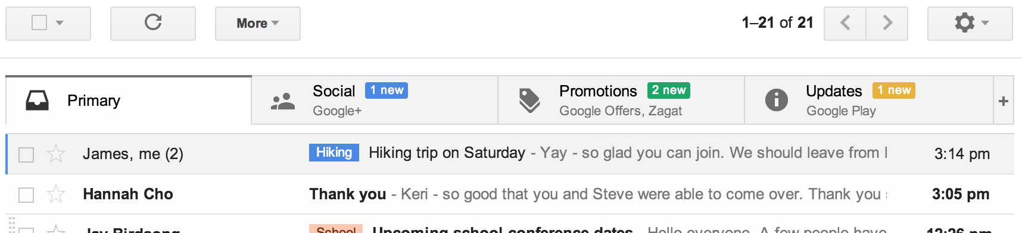
Text Classification
Phishing
www.wired.com

Slide 15
Question answering
'Watson' computer wins at 'Jeopardy'

Slide 16
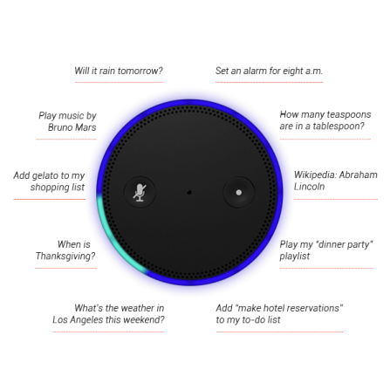
Natural language instruction
https://youtu.be/KkOCeAtKHIc?t=1m28s

Slide 17
Language Comprehension
Q: who wrote Winnie the Pooh?
Q: where is Chris lived?
Christopher Robin is alive and well. He is the same person that you read about in the book, Winnie the Pooh. As a boy, Chris lived in a pretty home called Cotchfield Farm. When Chris was three years old, his father wrote a poem about him. The poem was printed in a magazine for others to read. Mr. Robin then wrote a book

Slide 18
What are the challenges?
Paul Rad, Ph.D.
Associate Professor
Cyber Analytics and AI
Information Systems and Cyber Security
College of Business School
210.872.7259

Slide 19
Challenges – ambiguity
Word sense ambiguity

Slide 20
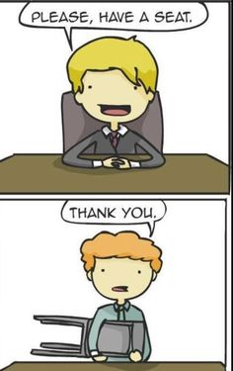
Word sense ambiguity

Slide 21
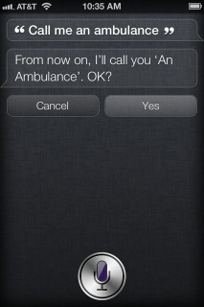
Challenges – ambiguity
Word sense / meaning ambiguity
Credit: http://stuffsirisaid.com

Slide 22
Challenges -- ambiguity
Ambiguous headlines:
Include your children when baking cookies
Local High School Dropouts Cut in Half
Hospitals are Sued by 7 Foot Doctors
Iraqi Head Seeks Arms
Safety Experts Say School Bus Passengers Should Be Belted
Teacher Strikes Idle Kids

Slide 23
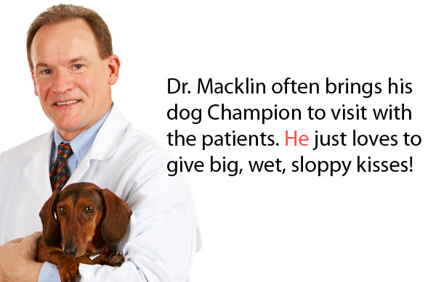
Challenges – ambiguity
Pronoun reference ambiguity
Credit: http://www.printwand.com/blog/8-catastrophic-examples-of-word-choice-mistakes

Slide 24
Challenges – language is not static
Language grows and changes
e.g., cyber lingo
LOL | Laugh out loud
G2G | Got to go
BFN | Bye for now
B4N | Bye for now
Idk | I don’t know
FWIW | For what it’s worth
LUWAMH | Love you with all my heart

Slide 25
Challenges – scale
Examples:
Bible (King James version): ~700K
Penn Tree bank ~1M from Wall street journal
Newswire collection: 500M+
Wikipedia: 2.9 billion word (English)
Web: several billions of words

Slide 26
Part of Speech Tagging
https://www.nltk.org

Slide 27
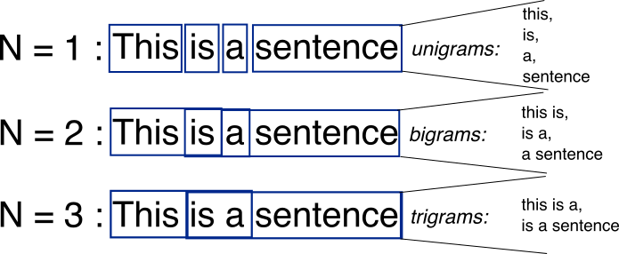
Bag-of-Words with N-grams
N-grams: a contiguous sequence of n tokens from a given piece of text
N-(N-grams -1)
http://recognize-speech.com/language-model/n-gram-model/comparison

Slide 28
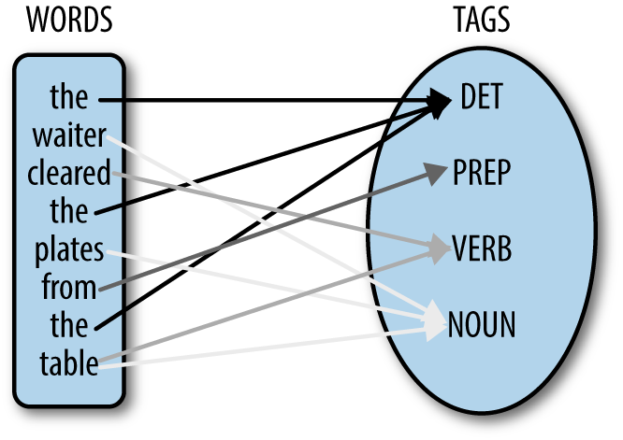
Part of Speech Tagging
part-of-speech tagging (POS tagging or PoS tagging or POST is the process of marking up a word in a text based on both its definition and its context—i.e., its relationship with adjacent and related words in a phrase, sentence, or paragraph. A simplified form of this is commonly taught to school-age children, in the identification of words as nouns, verbs, adjectives, adverbs, etc.

Slide 29
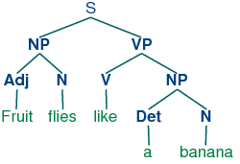
Syntactic parsing

